Slide 1
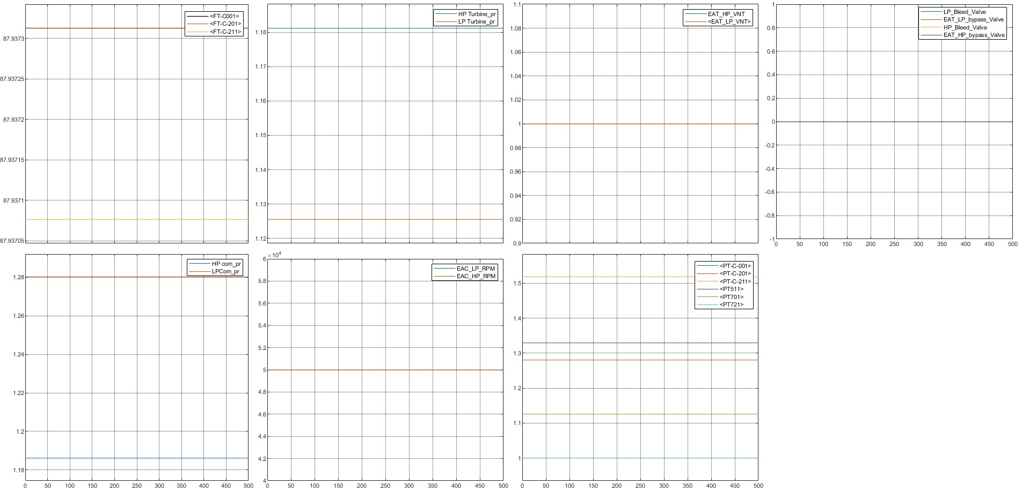
LP_RPM_50000 LP_Bleed_Valve_0 HP_Bleed_Valve_0 HP_RPM_50000 LP_Bypass_Valve_0 HP_Bypass_Valve_0

Slide 2
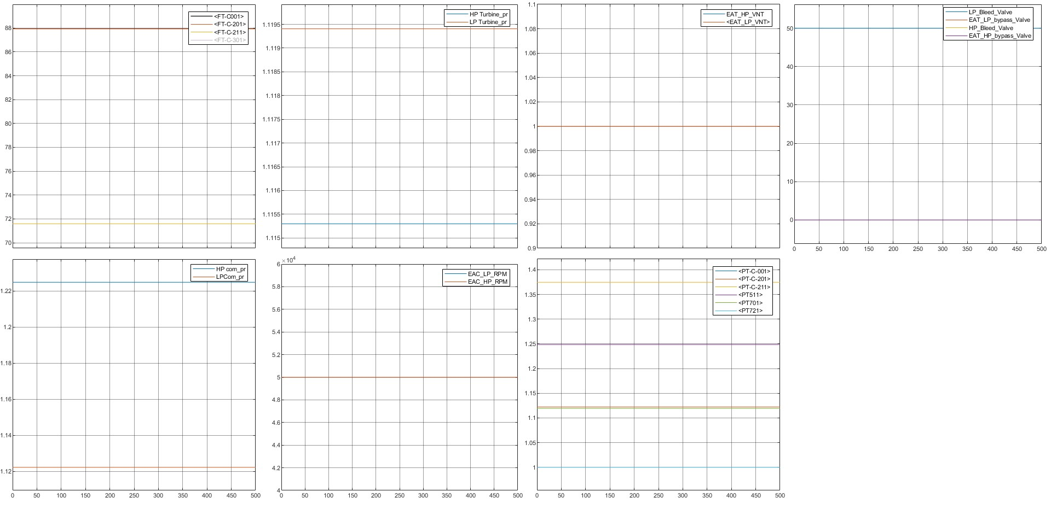
LP_RPM_50000 LP_Bleed_Valve_50 HP_Bleed_Valve_0 HP_RPM_50000 LP_Bypass_Valve_0 HP_Bypass_Valve_0

Slide 3
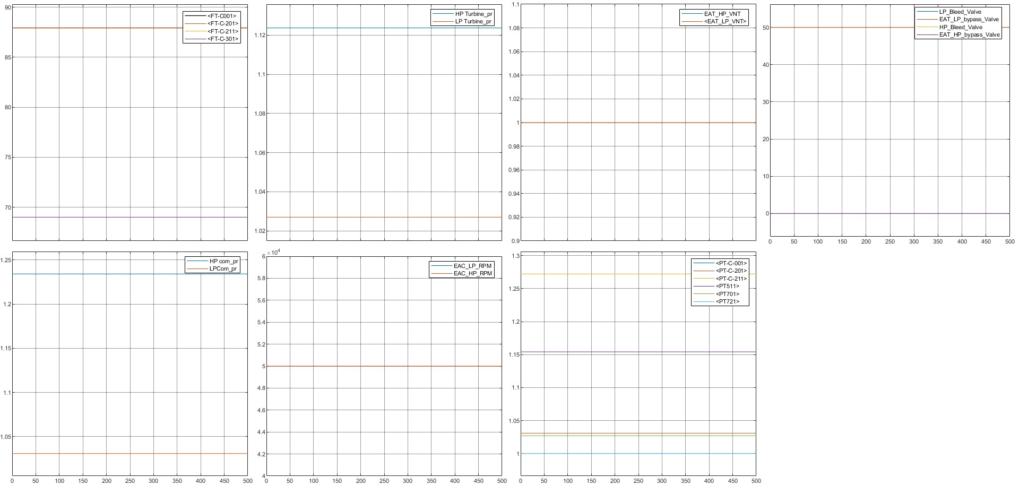
LP_RPM_50000 LP_Bleed_Valve_50 HP_Bleed_Valve_0 HP_RPM_50000 LP_Bypass_Valve_50 HP_Bypass_Valve_0

Slide 4
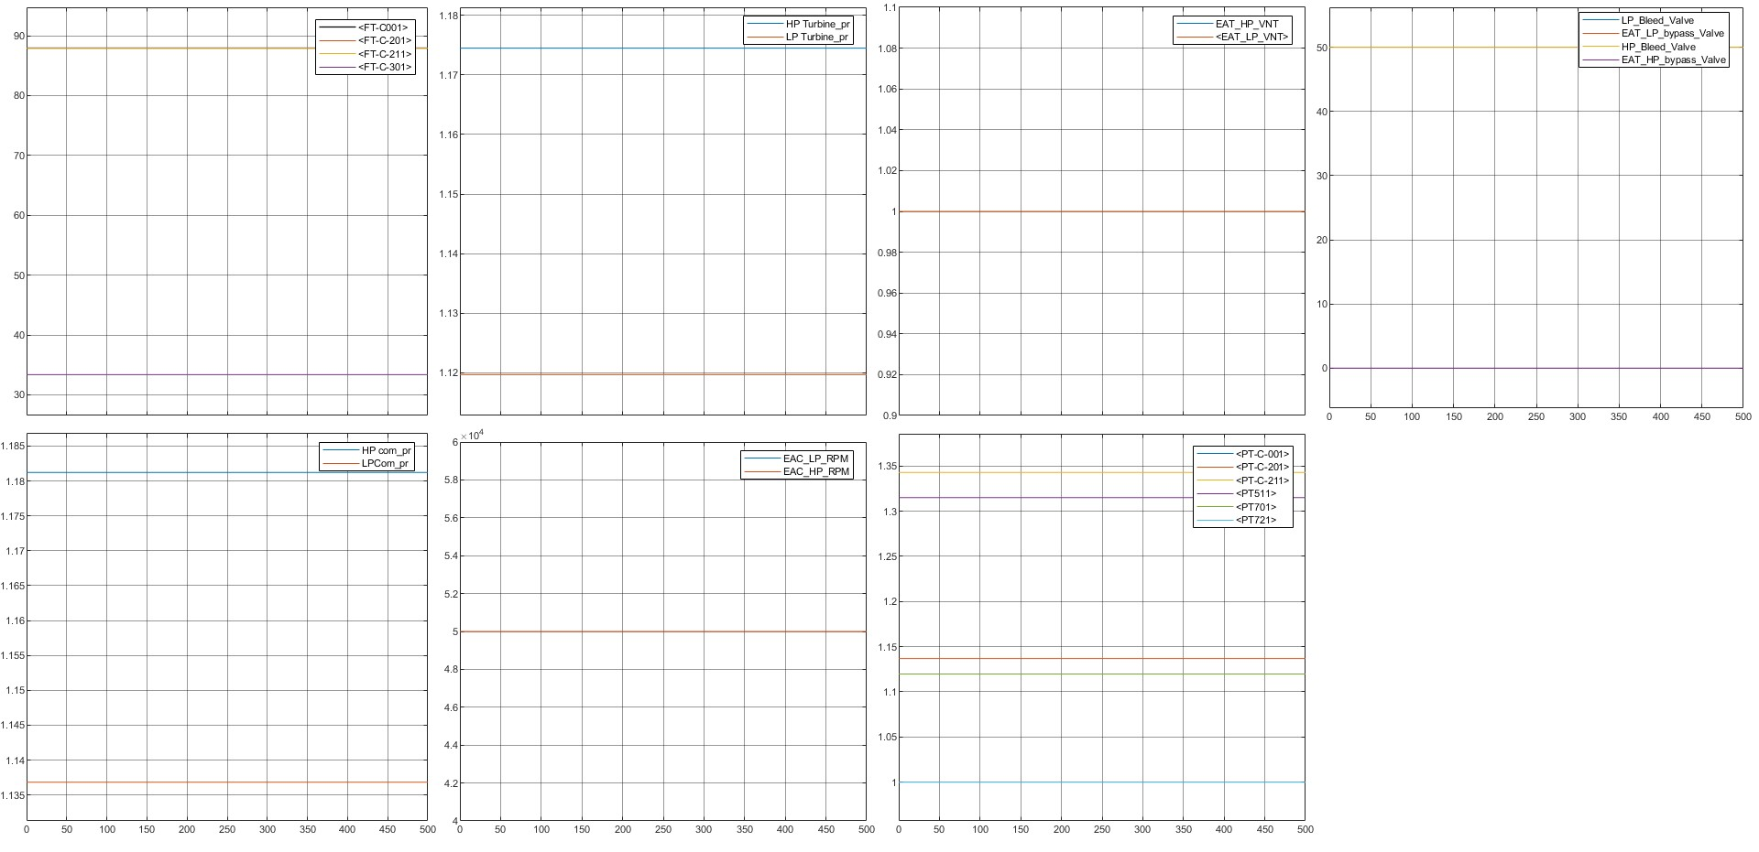
LP_RPM_50000 LP_Bleed_Valve_00 HP_Bleed_Valve_50 HP_RPM_50000 LP_Bypass_Valve_00 HP_Bypass_Valve_0

Slide 5
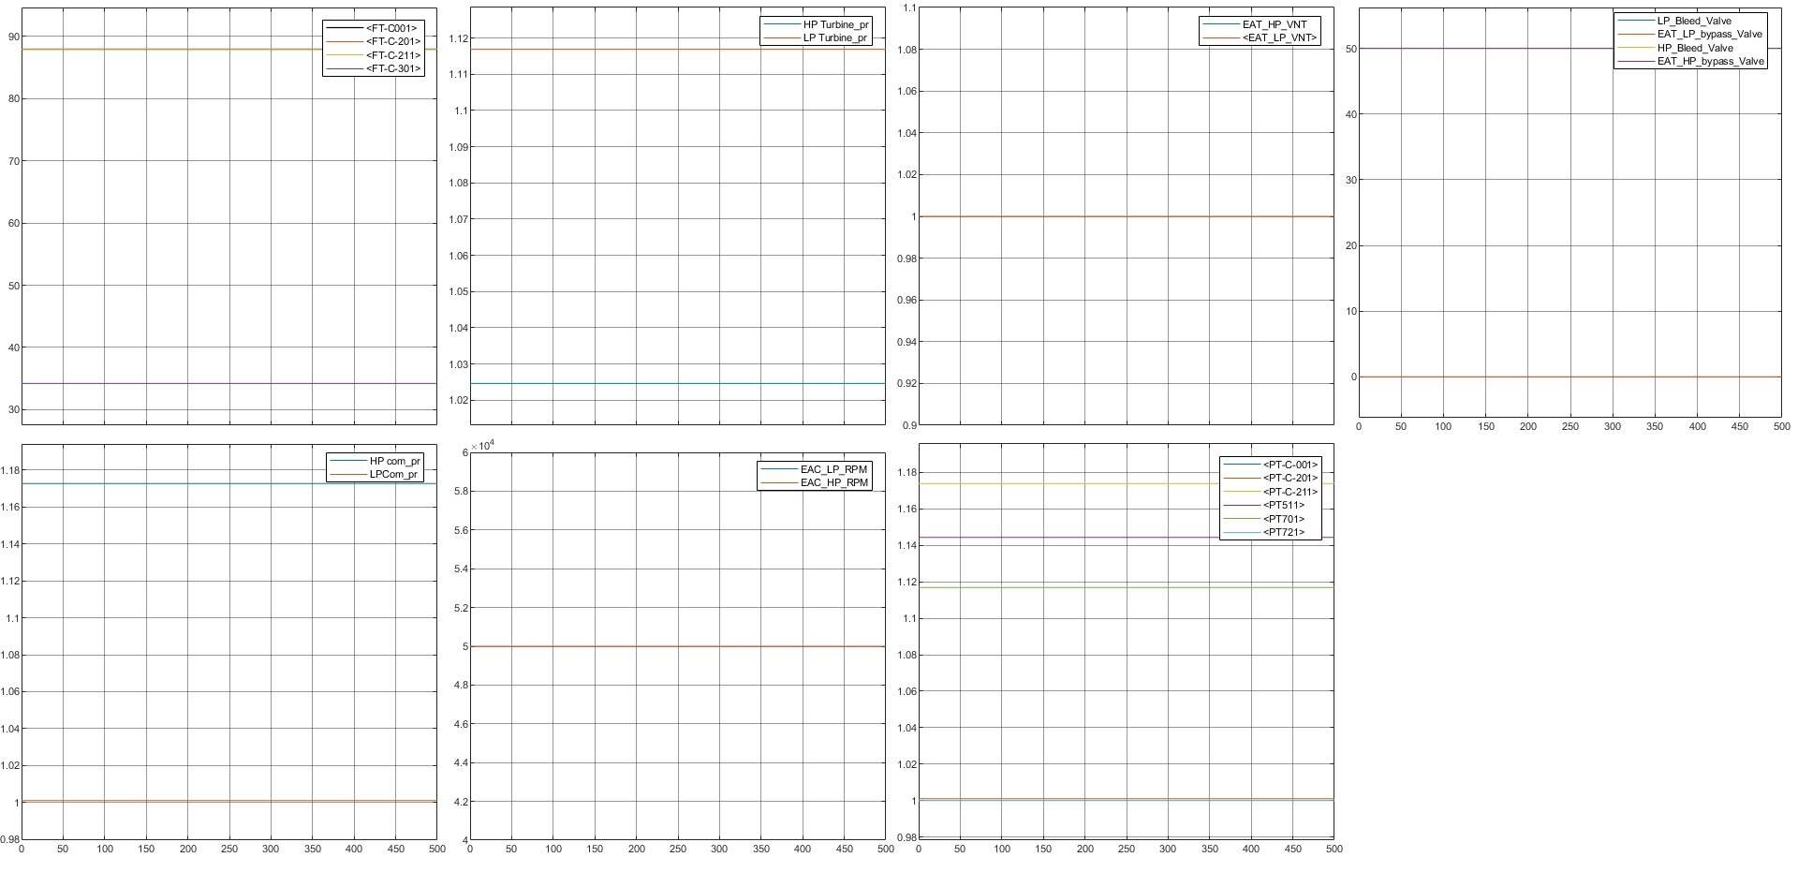
LP_RPM_50000 LP_Bleed_Valve_00 HP_Bleed_Valve_50 HP_RPM_50000 LP_Bypass_Valve_00 HP_Bypass_Valve_50

Slide 6
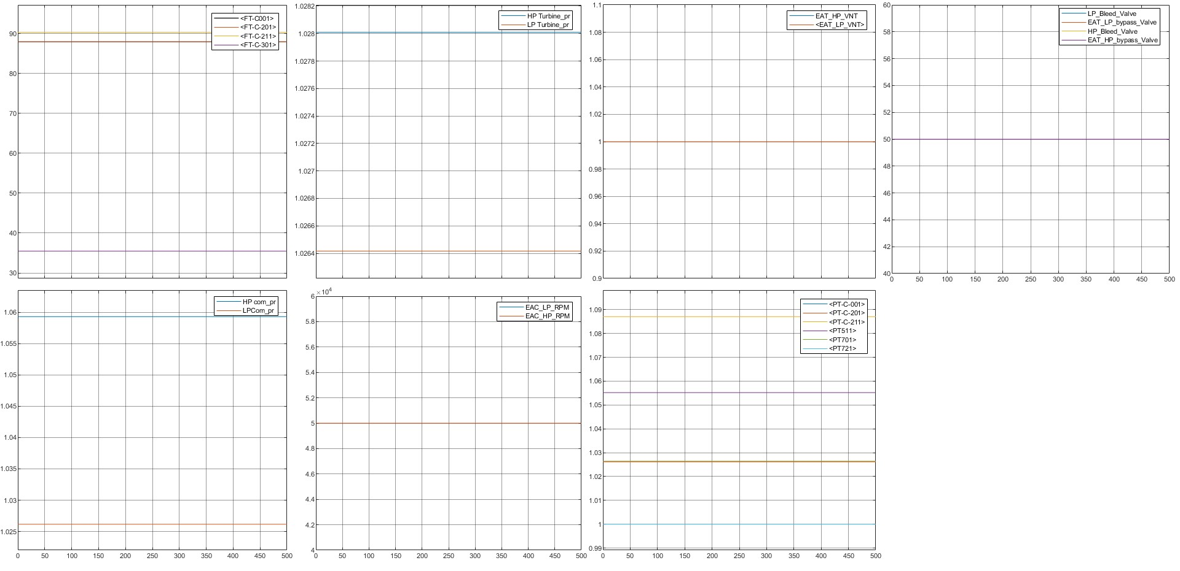
LP_RPM_50000 LP_Bleed_Valve_50 HP_Bleed_Valve_50 HP_RPM_50000 LP_Bypass_Valve_50 HP_Bypass_Valve_50

Slide 7
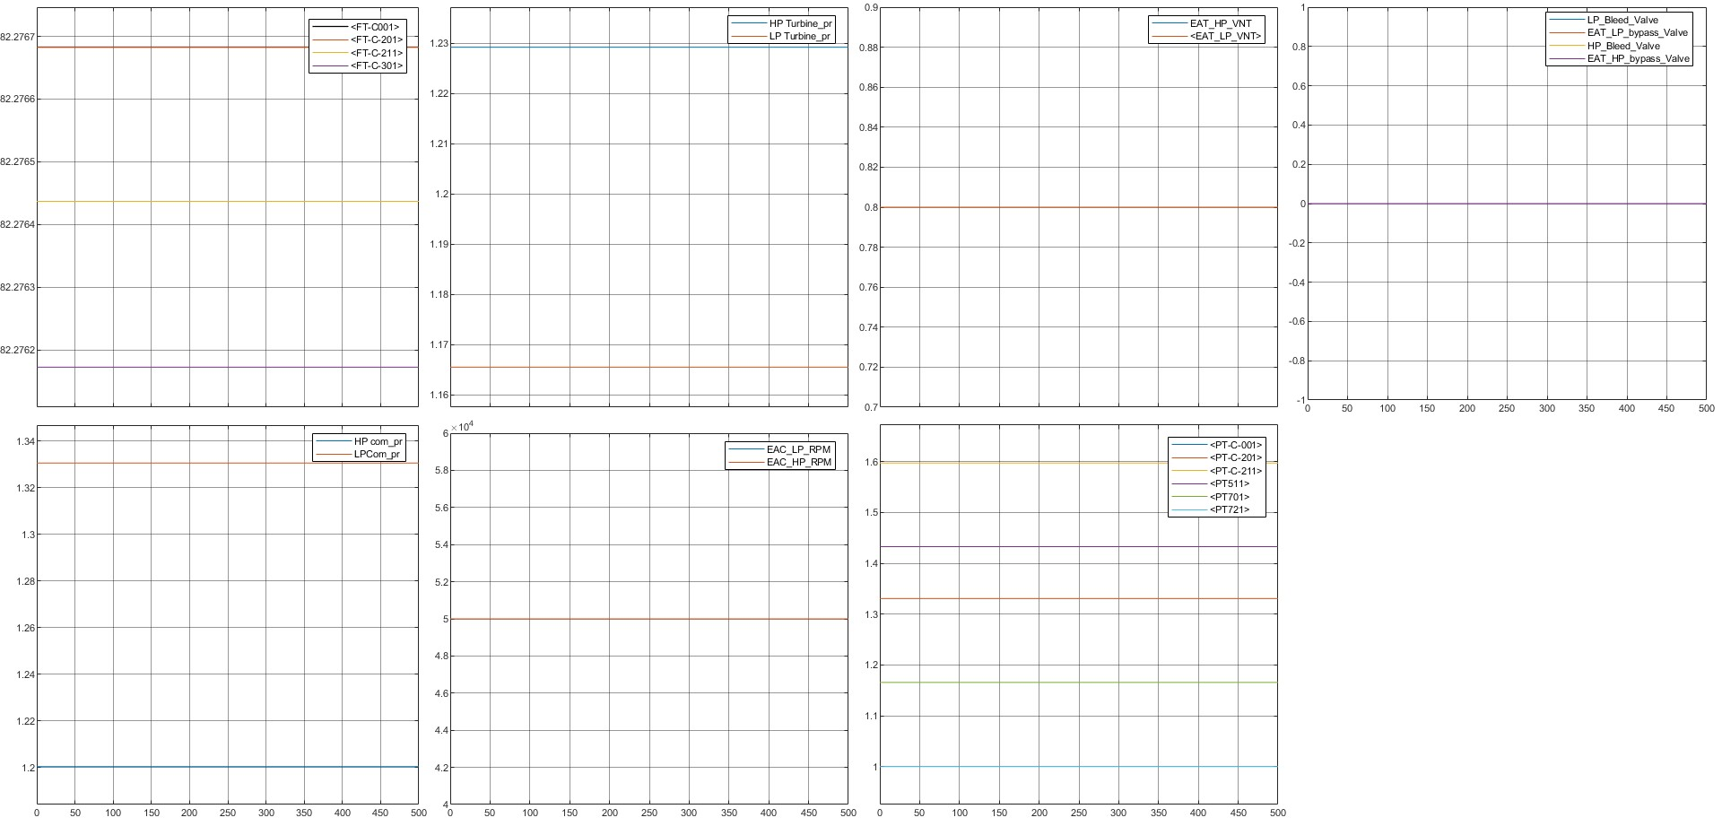
LP_RPM_50000 LP_Bleed_Valve_00 HP_Bleed_Valve_00 LP_VNT_0.8 HP_RPM_50000 LP_Bypass_Valve_00 HP_Bypass_Valve_00 HP_VNT_0.8

Slide 8
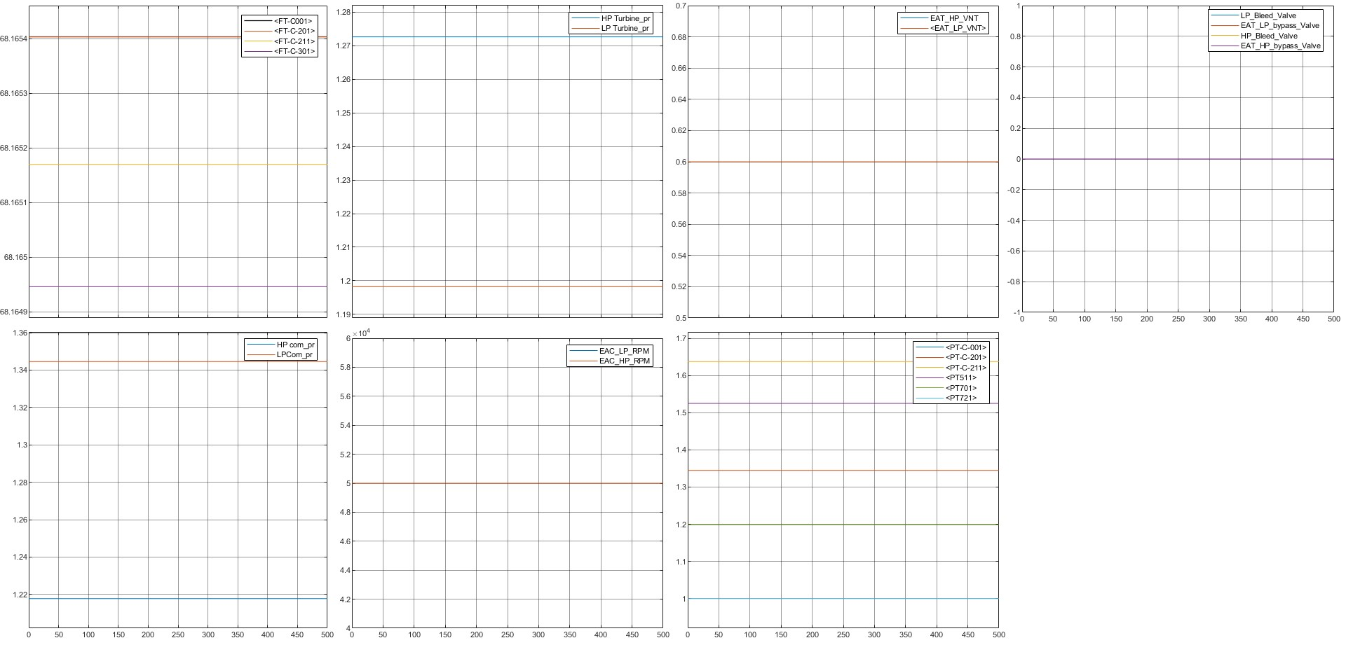
LP_RPM_50000 LP_Bleed_Valve_00 HP_Bleed_Valve_00 LP_VNT_0.6 HP_RPM_50000 LP_Bypass_Valve_00 HP_Bypass_Valve_00 HP_VNT_0.6

Slide 9
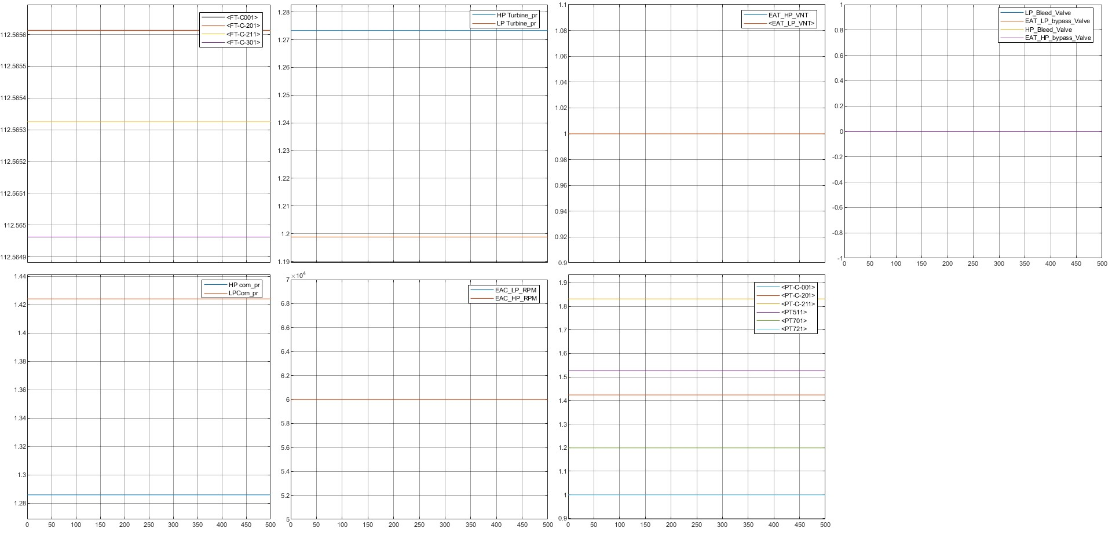
LP_RPM_60000 LP_Bleed_Valve_00 HP_Bleed_Valve_00 LP_VNT_1 HP_RPM_60000 LP_Bypass_Valve_00 HP_Bypass_Valve_00 HP_VNT_1

Slide 10
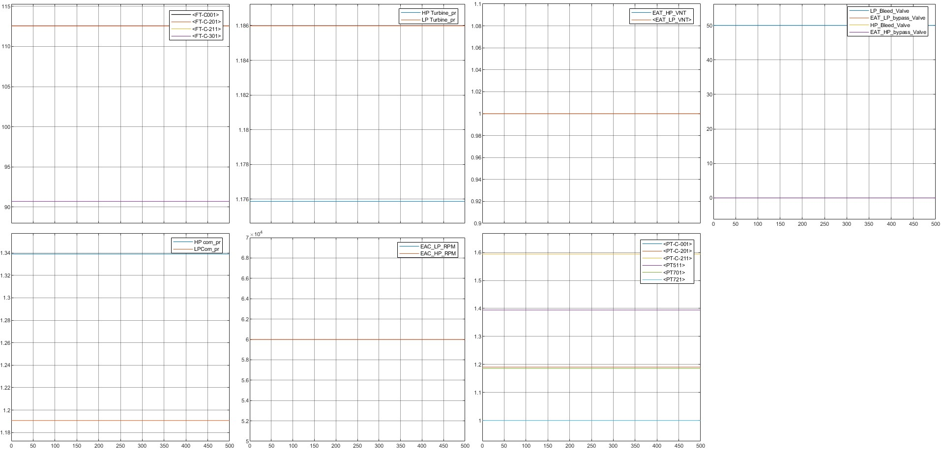
LP_RPM_60000 LP_Bleed_Valve_50 HP_Bleed_Valve_00 LP_VNT_1 HP_RPM_60000 LP_Bypass_Valve_00 HP_Bypass_Valve_00 HP_VNT_1

Slide 11
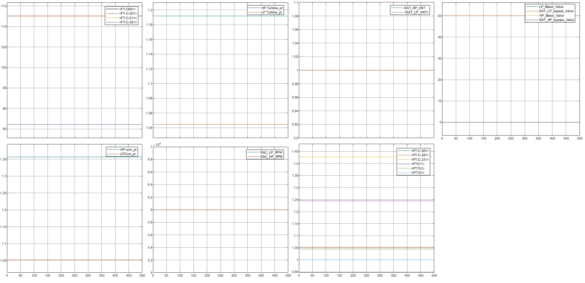
LP_RPM_60000 LP_Bleed_Valve_50 HP_Bleed_Valve_00 LP_VNT_1 HP_RPM_60000 LP_Bypass_Valve_50 HP_Bypass_Valve_00 HP_VNT_1

Slide 12
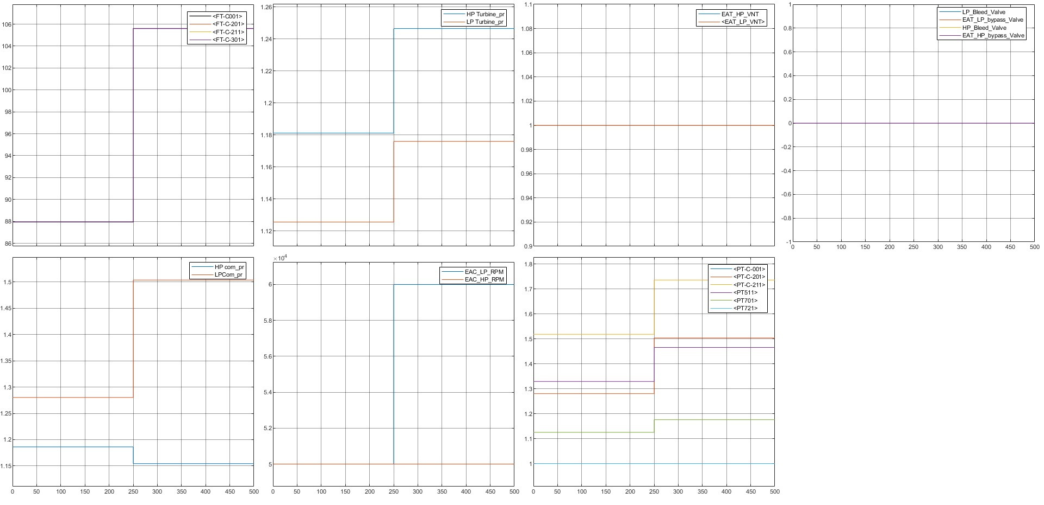
LP_RPM_50000--60000 LP_Bleed_Valve_00 HP_Bleed_Valve_00 LP_VNT_1 HP_RPM_50000 LP_Bypass_Valve_00 HP_Bypass_Valve_00 HP_VNT_1

Slide 13
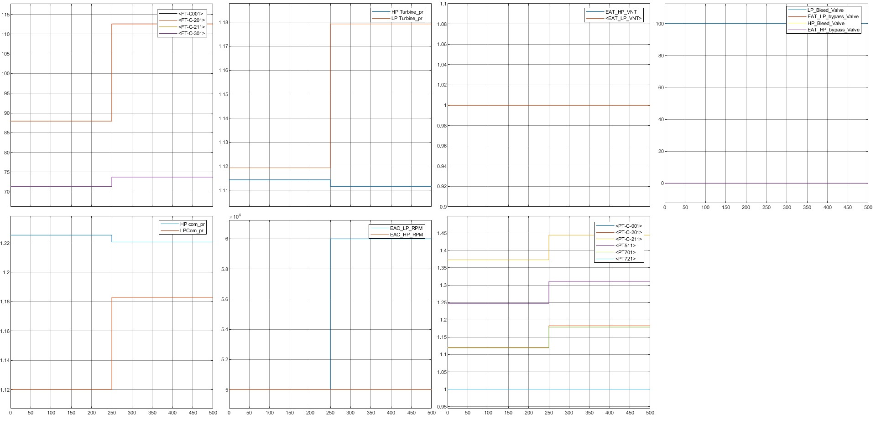
LP_RPM_50000--60000 LP_Bleed_Valve_100 HP_Bleed_Valve_00 LP_VNT_1 HP_RPM_50000 LP_Bypass_Valve_00 HP_Bypass_Valve_00 HP_VNT_1

Slide 14
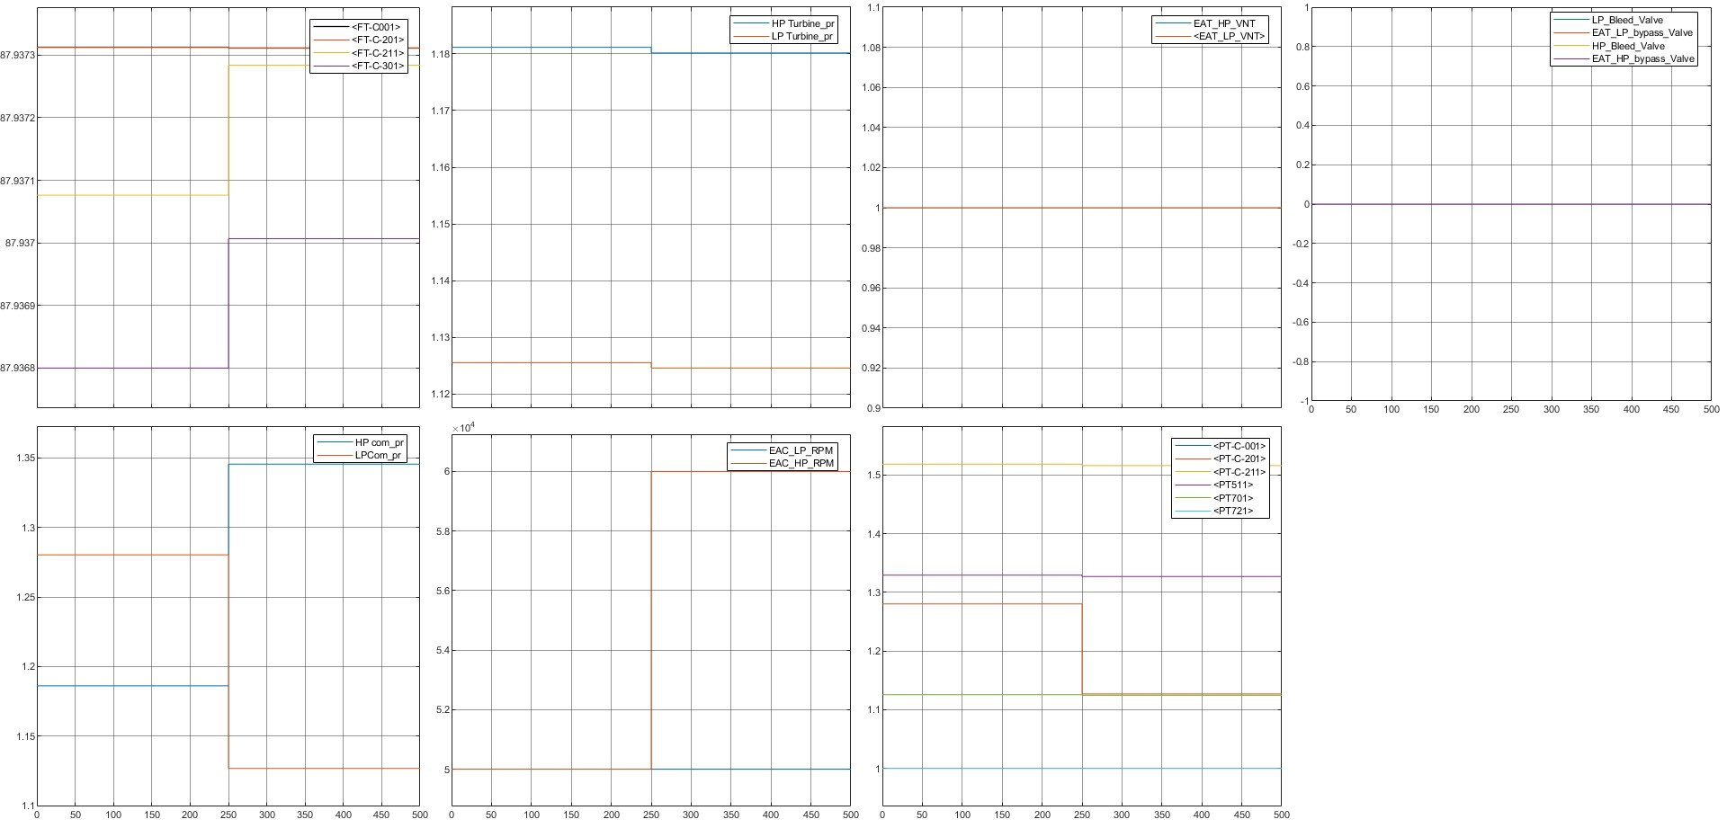
LP_RPM_50000 LP_Bleed_Valve_00 HP_Bleed_Valve_00 LP_VNT_1 HP_RPM_50000-60000 LP_Bypass_Valve_00 HP_Bypass_Valve_00 HP_VNT_1

Slide 15
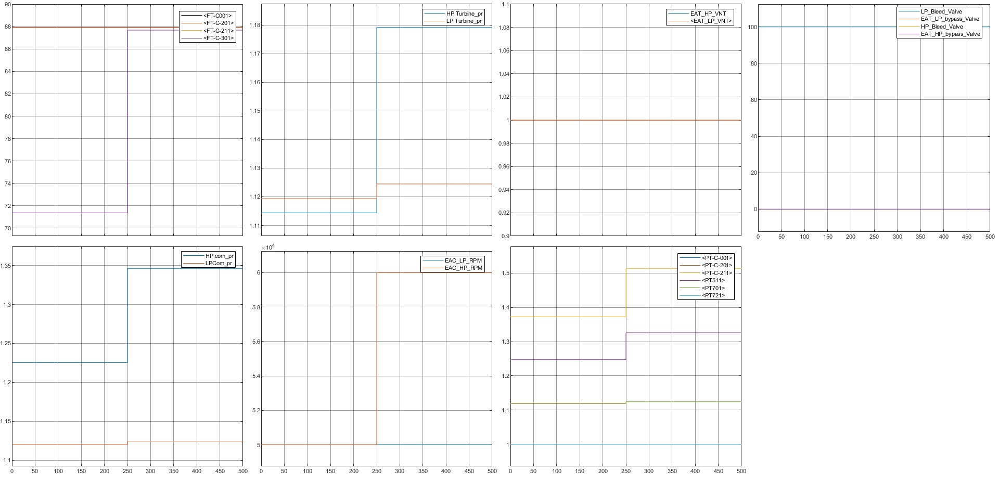
LP_RPM_50000 LP_Bleed_Valve_100 HP_Bleed_Valve_00 LP_VNT_1 HP_RPM_50000-60000 LP_Bypass_Valve_00 HP_Bypass_Valve_00 HP_VNT_1

Slide 16
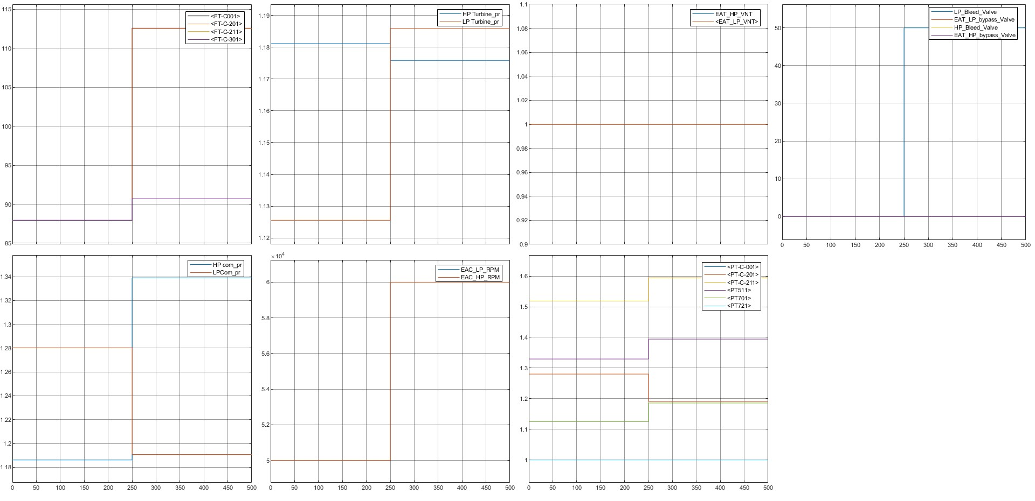
LP_RPM_50000_60000 LP_Bleed_Valve_100 HP_Bleed_Valve_00 LP_VNT_1 HP_RPM_50000-60000 LP_Bypass_Valve_00 HP_Bypass_Valve_00 HP_VNT_1

